Slide 1
DATABASE PROGRAMMING WITH JDBC
Instructor: DieuNT1
Notes:
<Lưu ý: không xóa nội dung cũ mà viết thêm lên trên như nhật ký>
Tài liệu đào tạo: <môn học, buổi học>
Phiên bản tài liệu:
Người cập nhật:
Ngày cập nhật:
Tóm tắt nội dung cập nhật chính:
Ngày ban hành sử dụng:

Slide 2
Table of contents
Java JDBC Tutorial
Working steps
DriverManager class
JDBC Statement
JDBC ResultSet
JDBC PreparedStatement (with Parameter)
Jdbc Callablestatement
Transaction Management in JDBC
Batch Processing in JDBC
Notes:
Prepare a DB for practical:
Person (ID, Name, Age),
Student(ID, PersonID, FSoftTool, RAnalyzeNote, DesignNote, CodeAndTesting, ProgrammingLanguageNote)
Professor(ID, PersonID, Seniority, Field);

Slide 3
Learning Approach
Strongly suggested for a better learning and understanding of this course:
Noting down the key concepts in the class
Analyze all the examples / code snippets provided
Study and understand the self study topics
Completion and submission of all the assignments, on time
Completion of the self review questions in the lab guide
Study and understand all the artifacts
Completion of the project on time inclusive of individual and group activities
Notes:
The following are strongly suggested for a better learning and understanding of this course:
Noting down the key concepts in the class
Analyze all the examples / code snippets provided
Study and understand the self study topics
Completion and submission of all the assignments, on time
Completion of the self review questions in the lab guide
Study and understand all the artifacts including the reference materials / e-learning / supplementary materials specified
Completion of the project (if application for this course) on time inclusive of individual and group activities
Taking part in the self assessment activities
Participation in the doubt clearing Sections

Slide 4
Java JDBC Tutorial
Section 1

Slide 5
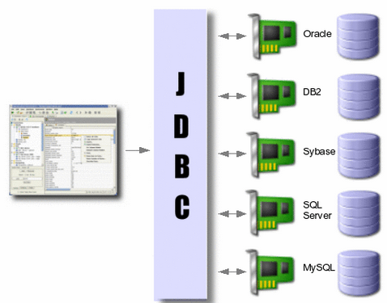
Overview
JDBC (Java Database Connectivity) API allows Java programs to connect to databases
Database access is the same for all database vendors
The JVM uses a JDBC driver to translate generalized JDBC calls into vendor specific database calls.
Notes:
History and implementation[edit]
Sun Microsystems released JDBC as part of Java Development Kit (JDK) 1.1 on February 19, 1997.^{[1]} Since then it has been part of the Java Platform, Standard Edition (Java SE).
The JDBC classes are contained in the Java package java.sql and javax.sql.
Starting with version 3.1, JDBC has been developed under the Java Community Process. JSR 54 specifies JDBC 3.0 (included in J2SE 1.4), JSR 114 specifies the JDBC Rowset additions, and JSR 221 is the specification of JDBC 4.0 (included in Java SE 6).^{[2]}
JDBC 4.1, is specified by a maintenance release 1 of JSR 221^{[3]} and is included in Java SE 7.^{[4]}
JDBC 4.2, is specified by a maintenance release 2 of JSR 221^{[5]} and is included in Java SE 8.^{[6]}
The latest version, JDBC 4.3, is specified by a maintenance release 3 of JSR 221^{[7]} and is included in Java SE 9.^{[8]}

Slide 6
Overview
JDBC API uses JDBC drivers to connect with the database. There are four types of JDBC drivers:
JDBC-ODBC Bridge Driver,
Native Driver,
Network Protocol Driver, and
Thin Driver
A JDBC driver is a set of Java classes that implement the JDBC interfaces,
targeting a specific database.

Slide 7
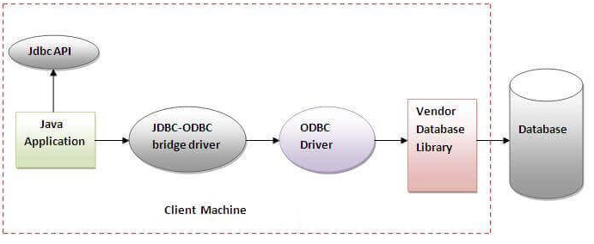
JDBC-ODBC bridge driver
The JDBC-ODBC bridge driver uses ODBC driver to connect to the database. The JDBC-ODBC bridge driver converts JDBC method calls into the ODBC function calls. This is now discouraged because of thin driver.
In Java 8, the JDBC-ODBC Bridge has been removed.
Oracle does not support the JDBC-ODBC Bridge from Java 8. Oracle recommends that you use JDBC drivers provided by the vendor of your database instead of the JDBC-ODBC Bridge.

Slide 8
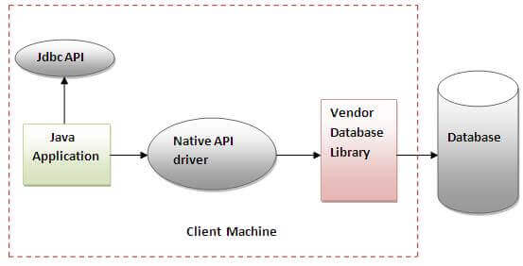
Native-API driver
The Native API driver uses the client-side libraries of the database. The driver converts JDBC method calls into native calls of the database API. It is not written entirely in java.
Advantage:
performance upgraded than JDBC-ODBC bridge driver.
Disadvantage:
The Native driver needs to be installed on the each client machine.
The Vendor client library needs to be installed on client machine.

Slide 9
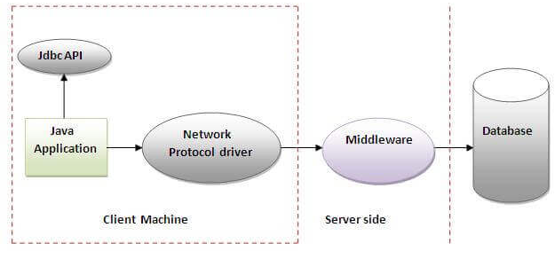
Network Protocol driver
The Network Protocol driver uses middleware (application server) that converts JDBC calls directly or indirectly into the vendor-specific database protocol. It is fully written in java.
Advantage:
No client side library is required because of application server that can perform many tasks like auditing, load balancing, logging etc.
Disadvantages:
Network support is required on client machine.
Requires database-specific coding to be done in the middle tier.
Maintenance of Network Protocol driver becomes costly because it requires database-specific coding to be done in the middle tier.

Slide 10
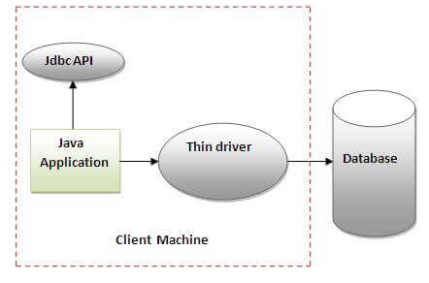
Thin driver
The thin driver converts JDBC calls directly into the vendor-specific database protocol. That is why it is known as thin driver. It is fully written in Java language.
Advantage:
Better performance than all other drivers.
No software is required at client side or server side.
Disadvantage:
Drivers depend on the Database.

Slide 11
Working steps
Section 2
Notes:
Year JDBC Version JSR Specification JDK Implementation
---- ------------ ----------------- ------------------
2017 JDBC 4.3 JSR 221 Java SE 9
2014 JDBC 4.2 JSR 221 Java SE 8
2011 JDBC 4.1 JSR 221 Java SE 7
2006 JDBC 4.0 JSR 221 Java SE 6
2001 JDBC 3.0 JSR 54 JDK 1.4
1999 JDBC 2.1 JDK 1.2?
1997 JDBC 1.2 JDK 1.1?

Slide 12
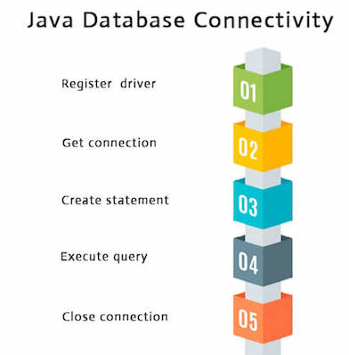
Working steps
Register the Driver class
Create connection
Create statement
Execute queries
Close connection
Notes:
Prepare a DB for practical:
Person (ID, Name, Age),
Student(ID, PersonID, FSoftTool, RAnalyzeNote, DesignNote, CodeAndTesting, ProgrammingLanguageNote)
Professor(ID, PersonID, Seniority, Field);

Slide 13
Register the driver class
The forName() method of Class class is used to register the driver class. This method is used to dynamically load the driver class.
Example to register the OracleDriver class:
Example to register the SQLServerDriver class:
Example to register the MySqlServerDriver class:
Note: Since JDBC 4.0, explicitly registering the driver is optional. We just need to put vender's Jar in the classpath, and then JDBC driver manager can detect and load the driver automatically.
Class.forName("oracle.jdbc.driver.OracleDriver");
Class.forName("com.microsoft.sqlserver.jdbc.SQLServerDriver");
Class.forName("com.mysql.jdbc.Driver");

Slide 14
Create Connection
The getConnection() method of DriverManager class is used to establish connection with the database.
Syntax of getConnection() method:
public static Connection getConnection(String url)throws SQLException
public static Connection getConnection(String url,String name,String password) throws SQLException
Example to establish connection with the Oracle database
Connection con=DriverManager.getConnection(
"jdbc:oracle:thin:@localhost:1521:xe","system","password");
Example to establish connection with the My SQL Server database
Connection conn = DriverManager.getConnection("jdbc:mysql://localhost:3306/ebookshop?
allowPublicKeyRetrieval=true&useSSL=false&serverTimezone=UTC",
"myuser", "xxxx");
Example to establish connection with the MS SQL Server database
String connectionUrl = "jdbc:sqlserver://localhost:1433;databaseName=Fsoft_Training";
Connection conn = DriverManager.getConnection(connectionUrl, "system","password");

Slide 15
Create Access Statement
The createStatement() method of Connection interface is used to create statement. The object of statement is responsible to execute queries with the database.
Use for general-purpose access to your database.
Useful when you are using static SQL statements at runtime.
The Statement interface cannot accept parameters.
Syntax:
Statement stmt = null;
try {
stmt = conn.createStatement(); // or
stmt = con.createStatement(ResultSetType,
ConcurencyType);
} catch (SQLException e) {
}
finally { stmt.close(); }

Slide 16
Execute the query
The executeQuery() method of Statement interface is used to execute queries to the database. This method returns the object of ResultSet that can be used to get all the records of a table.
Syntax of executeQuery() method:
public ResultSet executeQuery(String sql)throws SQLException
Example:
ResultSet rs = stmt.executeQuery("SELECT * FROM EMP");
while(rs.next()){
System.out.println(rs.getInt(1) + " " + rs.getString(2));
}

Slide 17
Close the connection object
By closing connection object statement and ResultSet will be closed automatically.
The close() method of Connection interface is used to close the connection.
Syntax of close() method:
Example:
con.close();
Note: Since Java 7, JDBC has ability to use try-with-resources statement to automatically close resources of type Connection, ResultSet, and Statement.
public void close() throws SQLException

Slide 18
DriverManager class
Section 3

Slide 19
DriverManager class
The DriverManager class acts as an interface between user and drivers. It keeps track of the drivers that are available and handles establishing a connection between a database and the appropriate driver.
The DriverManager class maintains a list of Driver classes that have registered themselves by calling the method DriverManager.registerDriver().
Methods:
Method | Description
1) public static void registerDriver(Driver driver) | is used to register the given driver with DriverManager.
2) public static void deregisterDriver(Driver driver) | is used to deregister the given driver (drop the driver from the list) with DriverManager.
3) public static Connection getConnection(String url) | is used to establish the connection with the specified url.
4) public static Connection getConnection(String url, String userName, String password) | is used to establish the connection with the specified url, username and password.

Slide 20
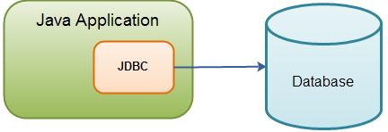
Connection interface
A Connection is the session between Java application and database.
The Connection interface is a factory of Statement, PreparedStatement and DatabaseMetaData.
By default, connection commits the changes after executing queries.
Methods:
public Statement createStatement(): creates a statement object that can be used to execute SQL queries.
public Statement createStatement(int resultSetType, int
resultSetConcurrency):
creates a Statement object that will generate ResultSet objects with the given type and concurrency.
public void setAutoCommit(boolean status): is used to set the commit status. By default it is true.

Slide 21
Connection interface
Methods:
public void commit(): saves the changes made since the previous commit/rollback permanent.
public void rollback(): drops all changes made since the previous commit/rollback.
public void close(): closes the connection and Releases a JDBC resources immediately
public PreparedStatement prepareStatement(): creates a JDBC PreparedStatement object.
public DatabaseMetaData getMetaData(): returns a JDBC DatabaseMetaData object which can be used to introspect the database the JDBC Connection is connected to

Slide 22
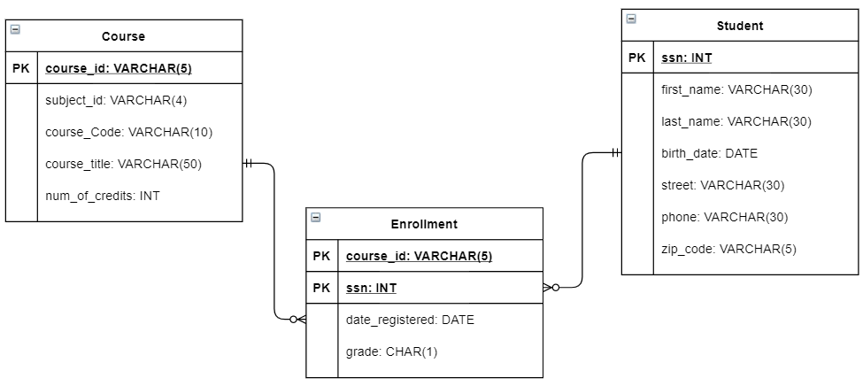
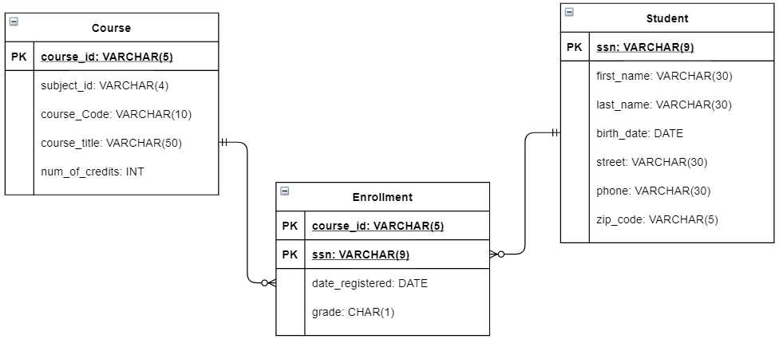
DB Sample
Create a Database for Training Management System (TrainingDB) includes the following tables as:

Slide 23
JDBC Statement
Section 4

Slide 24
Statement interface
The Statement interface provides methods to execute queries with the database. The statement interface is a factory of ResultSet i.e. it provides factory method to get the object of ResultSet.
Create Statement:
Statement statement = connection.createStatement();
Statement statement = connection.createStatement(
int resultSetType, int resultSetConcurrency);
Statement statement = connection.createStatement(
int resultSetType, int resultSetConcurrency,
int resultSetHoldability)

Slide 25
Statement interface
Statement’s methods:
boolean execute(String SQL) : may be any kind of SQL statement. Returns a boolean value of true if a ResultSet object can be retrieved; false if the first result is an update count or there is no result.
int executeUpdate(String SQL) : Returns the numbers of rows affected by the execution of the SQL statement. Use this method to execute SQL statements for which you expect to get a number of rows affected - for example, an INSERT, UPDATE, or DELETE statement.
ResultSet executeQuery(String SQL) : Returns a ResultSet object. Use this method when you expect to get a result set, as you would with a SELECT statement.
public int[] executeBatch(): is used to execute batch of commands.

Slide 26
Examples
Example 1: Execute a SELECT query via a Statement
// Create and execute an SQL statement that returns some data.
String SQL1 = "SELECT TOP 10 * FROM Person";
Statement stmt=conn.createStatement();
//ResultSet.TYPE_SCROLL_SENSITIVE,ResultSet.CONCUR_UPDATABLE
ResultSet rs = stmt.executeQuery(SQL);
Example 2: Execute an INSERT via a Statement
// Create and execute an SQL statement that returns some data.
String SQL2 = "INSERT INTO STOCK(STOCK_CODE, STOCK_NAME)
VALUES('11', 'STOCK1')";
Statement stmt = conn.createStatement();
int no_of_row = stmt.executeUpdate(SQL);

Slide 27
Retrieve Data & Close Connection
Retrieve data
// Iterate through the data in the result set and display it.
while (rs.next()) {
System.out.println(rs.getInt(1) + "\t" +
rs.getString(2)+"\t"+rs.getInt(3));
}
Close connection
statement.close();
conn.close();

Slide 28
Statement Using Java Try With Resources
In order to close a Statement correctly after use, you can open it inside a Java Try With Resources block.
Here is an example of closing a Java JDBC Statement instance using the try-with-resources construct:
Once the try block exits, the Statement will be closed automatically.
try (Statement statement = connection.createStatement()) {
// use the statement in here.
} catch (SQLException e) {
// TODO: handle exception
}

Slide 29
JDBC resultset
Section 5

Slide 30
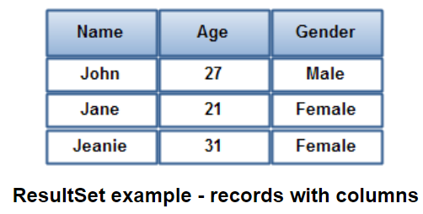
Overview
The Java JDBC java.sql.ResultSet interface represents the result of a database query.
This ResultSet is then iterated to inspect the result.
A ResultSet Contains Records:
A JDBC ResultSet contains records. Each records contains a set of columns. Each record contains the same amount of columns, although not all columns may have a value. A column can have a null value.
The following ResultSet has 3 different columns (Name, Age, Gender), and 3 records with different values for each column

Slide 31
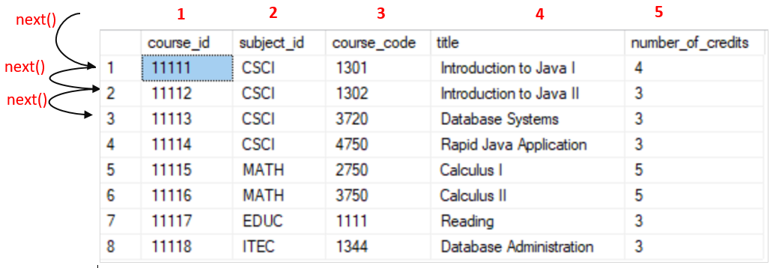
Creating a ResultSet
You create a ResultSet by executing a Statement or PreparedStatement, like this:
Or like this:
ResultSet data:
Statement statement = connection.createStatement();
ResultSet result = statement.executeQuery("SELECT * FROM dbo.Course");
String selectQuery = "SELECT * FROM dbo.Course";
PreparedStatement statement = connection.prepareStatement(selectQuery);
ResultSet result = statement.executeQuery();
while (result.next()) {
System.out.println(result.getString(1)
+ "\t" + result.getString(2)
+ "\t" + result.getString(3)
+ "\t" + result.getString(4)
+ "\t" + result.getInt(5));
}

Slide 32
ResultSet Type, Concurrency
When you create a ResultSet there are three attributes you can set:
Type
Concurrency
// for use with ResultSet only
// No “previous” method using, no update
Statement statement = connection.createStatement(
ResultSet.TYPE_FORWARD_ONLY,
ResultSet.CONCUR_READ_ONLY,
ResultSet.HOLD_CURSORS_OVER_COMMIT);
// with “previous” method using, update
Statement statement = connection.createStatement(
ResultSet.TYPE_SCROLL_SENSITIVE,
ResultSet.CONCUR_UPDATABLE);

Slide 33
JDBC Resultset
Type of ResultSet: The possible Type are given below, If you do not specify any ResultSet type, you will automatically get one that is TYPE_FORWARD_ONLY.
Type | Description
ResultSet. TYPE_FORWARD_ONLY | The cursor can only move forward in the result set.
ResultSet. TYPE_SCROLL_INSENSITIVE | The cursor can scroll forwards and backwards, and the result set is not sensitive to changes made by others to the database that occur after the result set was created.
ResultSet. TYPE_SCROLL_SENSITIVE | The cursor can scroll forwards and backwards, and the result set is sensitive to changes made by others to the database that occur after the result set was created.

Slide 34
JDBC Resultset
Concurrency of ResultSet: The possible RSConcurrency are given below, If you do not specify any Concurrency type, you will automatically get one that is CONCUR_READ_ONLY.
Concurrency | Description
ResultSet.CONCUR_READ_ONLY | Creates a read-only result set. This is the default
ResultSet.CONCUR_UPDATABLE | Creates an updateable result set.

Slide 35
JDBC Resultset
ResultSet methods:
.N. | Methods & Description
1 | public void beforeFirst() throws SQLException Moves the cursor to just before the first row
2 | public void afterLast() throws SQLException Moves the cursor to just after the last row
3 | public boolean first() throws SQLException Moves the cursor to the first row
4 | public void last() throws SQLException Moves the cursor to the last row.
5 | public boolean absolute(int row) throws SQLException Moves the cursor to the specified row
6 | public boolean relative(int row) throws SQLException Moves the cursor the given number of rows forward or backwards from where it currently is pointing.

Slide 36
JDBC Resultset
ResultSet methods:
.N. | Methods & Description
7 | public boolean previous() throws SQLException Moves the cursor to the previous row. This method returns false if the previous row is off the result set
8 | public boolean next() throws SQLException Moves the cursor to the next row. This method returns false if there are no more rows in the result set
9 | public int getRow() throws SQLException Returns the row number that the cursor is pointing to.
10 | public void moveToInsertRow() throws SQLException Moves the cursor to a special row in the result set that can be used to insert a new row into the database. The current cursor location is remembered.
11 | public void moveToCurrentRow() throws SQLException Moves the cursor back to the current row if the cursor is currently at the insert row; otherwise, this method does nothing

Slide 37
JDBC Resultset
Viewing a Result Set:
S.N. | Methods & Description
1 | public int getInt(String columnName) throws SQLException Returns the int in the current row in the column named columnName
2 | public int getInt(int columnIndex) throws SQLException Returns the int in the current row in the specified column index. The column index starts at 1, meaning the first column of a row is 1, the second column of a row is 2, and so on.
3 | public XXX getXXX(int columnIndex) throws SQLException

Slide 38
JDBC Resultset
The ResultSet interface contains a collection of update methods for updating the data of a result set.
As with the get methods, there are two update methods for each data type:
One that takes in a column name.
One that takes in a column index.
For example:
S.N. | Methods & Description
1 | public void updateString(int columnIndex, String s) throws SQLException Changes the String in the specified column to the value of s.
2 | public void updateString(String columnName, String s) throws SQLException Similar to the previous method, except that the column is specified by its name instead of its index.

Slide 39
ResultSet Example
public List<Course> findCourseByName(String name) throws SQLException {
Connection connection = null;
Statement statement = null;
ResultSet result = null;
List<Course> courses = new ArrayList<Course>();
try {
connection = DBUtils.getConnection();
statement = connection.createStatement(ResultSet.TYPE_FORWARD_ONLY,
ResultSet.CONCUR_READ_ONLY);
result = statement.executeQuery(
"SELECT * FROM dbo.Course WHERE title LIKE '%" + name + "%'");
Course course;

Slide 40
ResultSet Example
while (result.next()) {
course = new Course(result.getString(1), result.getString(2),
result.getString(3), result.getString(4), result.getInt(5));
courses.add(course);
}
} finally {
if (statement != null) {
statement.close();
}
if (result != null) {
result.close();
}
}
return courses;
}

Slide 41
ResultSet Example
public class CourseTest {
public static void main(String[] args) {
CourseDao courseDao = new CourseDaoImpl();
String name = "Java";
try {
List<Course> courses = courseDao.findCourseByName(name);
courses.forEach(c -> System.out.println(c));
} catch (SQLException e) {
e.printStackTrace();
}
}
}

Slide 42
JDBC Update using ResultSet
ResultSet rs = statement.executeQuery(query);
…
// for update
rs.updateBoolean(1, false); // change the first column
rs.updateInt(“Age”, 25); // change the column named “Age”
rs.updateRow();
// to delete
rs.deleteRow();

Slide 43
JDBC PreparedStatement (with Parameter)
Section 6

Slide 44
PreparedStatement Interface
The PreparedStatement interface extends the Statement interface which gives you added functionality with a couple of advantages over a generic Statement object.
It is used to execute parameterized query.
Improves performance: The performance of the application will be faster if you use PreparedStatement interface because query is compiled only once.
public interface PreparedStatement extends Statement {
}

Slide 45
PreparedStatement Interface
The prepareStatement() method of Connection interface is used to return the object of PreparedStatement.
Syntax:
This statement gives you the flexibility of supplying arguments dynamically.
public PreparedStatement prepareStatement(String query)
throws SQLException{}
PreparedStatement pstmt = null;
try {
String SQL = "Update Employees SET age = ? WHERE id = ?";
pstmt = conn.prepareStatement(SQL);
} catch (SQLException e) {
//TODO
} finally {
//TODO
}

Slide 46
Methods of PreparedStatement interface
Method | Description
public void setInt(int paramIndex, int value) | Sets the integer value to the given parameter index.
public void setString(int paramIndex, String value) | Sets the String value to the given parameter index.
public void setFloat(int paramIndex, float value) | Sets the float value to the given parameter index.
public void setDouble(int paramIndex, double value) | Sets the double value to the given parameter index.
public int executeUpdate() | Executes the query. It is used for create, drop, insert, update, delete etc.
public ResultSet executeQuery() | Executes the select query. It returns an instance of ResultSet.
Notes:
Store Image:
1) public void setBinaryStream(int paramIndex,InputStream stream) throws SQLException
2) public void setBinaryStream(int paramIndex,InputStream stream,long length) throws SQLException
SQL Server: dùng VARBINARY
// Method used to insert a stream of bytes
pstmt.setBinaryStream(3, fis, len);
Oracle:
For storing image into the database, BLOB (Binary Large Object) datatype is used in the table. For example:
CREATE TABLE "IMGTABLE" (
"NAME" VARCHAR2(4000),
"PHOTO" BLOB
)
Retrieve Image:
byte[] fileBytes = rs.getBytes(1);
OutputStream targetFile= new FileOutputStream("d://filepath//new.JPG");
targetFile.write(fileBytes);
targetFile.close();

Slide 47
JDBC With Parameter
The setXXX() methods bind values to the parameters.
Examples:
pstmt.setInt(1,23);
pstmt.setString(2,"Roshan");
pstmt.setString(3,"CEO");
pstmt.executeUpdate();

Slide 48
PreparedStatement Example
public boolean save(Course course) throws SQLException {
PreparedStatement preparedStatement = null;
Connection connection = null;
int result;
try {
connection = DBUtils.getConnection();
String query = "INSERT INTO dbo.Course VALUES (?,?,?,?,?)";
preparedStatement = connection.prepareStatement(query);
preparedStatement.setString(1, course.getCourseId());
preparedStatement.setString(2, course.getSubjectId());
preparedStatement.setString(3, course.getCourseCode());
preparedStatement.setString(4, course.getCourseTitle());
preparedStatement.setInt(5, course.getNumOfCredits());
result = preparedStatement.executeUpdate();
} finally {
if (preparedStatement != null) {
preparedStatement.close();
}
if (connection != null) {
connection.close();
}
}
return (result > 0);
}

Slide 49
PreparedStatement Example
public static void main(String[] args) {
CourseDao courseDao = new CourseDaoImpl();
Course course = new Course("11119", "ITC", "1205",
"Java SE Programming Language", 5);
try {
boolean resultSave = courseDao.save(course);
System.out.println(resultSave);
} catch (SQLException e1) {
e1.printStackTrace();
}
}
Results:
true

Slide 50
Jdbc Callablestatement
Section 7

Slide 51
CallableStatement Interface
CallableStatement interface is used to call the stored procedures and functions.
We can have business logic on the database by the use of stored procedures and functions that will make the performance better because these are precompiled.
Example: you need the get the age of the employee based on the date of birth, you may create a function that receives date as the input and returns age of the employee as the output.
How to get the instance of CallableStatement:
The prepareCall() method of Connection interface returns the instance of CallableStatement.
Syntax:
CallableStatement stmt=con.prepareCall("{call myprocedure(?,?)}");

Slide 52
CallableStatement Example
For User Stored Prodecure:
CREATE PROCEDURE usp_UpdateCourse(
@course_idVARCHAR(5),
@subject_idVARCHAR(4),
@course_codeVARCHAR(10),
@titleVARCHAR(50),
@number_of_creditsINT,
@statusVARCHAR(10) OUTPUT
)
AS
BEGIN
SET NOCOUNT ON;
UPDATE dbo.Course
SET subject_id = @subject_id,
title = @title,
number_of_credits = @number_of_credits
WHERE course_code = @course_code;
IF(@@ROWCOUNT > 0 )
BEGIN
SET @status = 'success';
END
ELSE
BEGIN
SET @status = 'fail';
END
END

Slide 53
CallableStatement Example
public boolean update(Course course) throws SQLException {
CallableStatement callableStatement = null;
Connection connection = null;
int result;
try {
connection = DBUtils.getConnection();
callableStatement = connection
.prepareCall("{CALL usp_UpdateCourse(?,?,?,?,?,?)}");
callableStatement.setString(1, course.getCourseId());
callableStatement.setString(2, course.getSubjectId());
callableStatement.setString(3, course.getCourseCode());
callableStatement.setString(4, course.getCourseTitle());
callableStatement.setInt(5, course.getNumOfCredits());
callableStatement.registerOutParameter(6, Types.INTEGER);
callableStatement.execute();
result = callableStatement.getInt(6);

Slide 54
CallableStatement Example
} finally {
if (callableStatement != null) {
callableStatement.close();
}
if (connection != null) {
connection.close();
}
}
return (result > 0);
}
public class CourseTest {
public static void main(String[] args) {
CourseDao courseDao = new CourseDaoImpl();
Course course = new Course("11120", "ITCS", "1206", "Technologies for Java Web 2", 5);
try {
boolean resultSave = courseDao.update(course);
System.out.println(resultSave);
} catch (SQLException e1) {
e1.printStackTrace();
}
}

Slide 55
Transaction Management in JDBC
Section 8

Slide 56
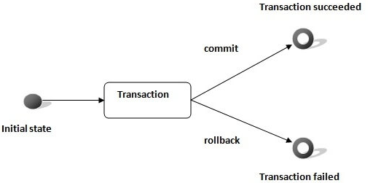
Transaction
Transaction represents a single unit of work.
The ACID properties describes the transaction management well.
ACID stands for Atomicity, Consistency, isolation and durability.
Atomicity means either all successful or none.
Consistency ensures bringing the database from one consistent state to another consistent state.
Isolation ensures that transaction is isolated from other transaction.
Durability means once a transaction has been committed, it will remain so, even in the event of errors, power loss etc.

Slide 57
Transaction
Connection interface provides methods to manage transaction.
Advantage of Transaction Mangaement
Fast performance: It makes the performance fast because database is hit at the time of commit.
Method | Description
void setAutoCommit(boolean status) | It is true bydefault means each transaction is committed bydefault.
void commit() | Commits the transaction.
void rollback() | Cancels the transaction.

Slide 58
JDBC With Parameter
// in string query using Statement
String query = “INSERT INTO Person “ +
“VALUES (” + <name> + “, ”
<age> + … + “)”;
// using PreparedStatement
String query = “INSERT INTO Person “ +
“VALUES (?, ?)”
PreparedStatement statement = connect.prepareStatement(query);
connect.setAutoCommit(false);
statement.setString(1, “Titi”);
statement.setInt(2, 25);
statement.executeQuery(); // insert 1
statement.setString(1, “Tata”);
statement.setInt(2, 28);
statement.executeQuery(); // Insert 2
connect.commit();
connect.setAutoCommit(true);

Slide 59
Transaction Example
public boolean saveAll(List<Course> courses) throws SQLException {
PreparedStatement preparedStatement = null;
Connection connection = null;
int result = 0;
try {
connection = DBUtils.getConnection();
connection.setAutoCommit(false);
String query = "INSERT INTO dbo.Course VALUES (?,?,?,?,?)";
preparedStatement = connection.prepareStatement(query);
for (Course course : courses) {
preparedStatement.setString(1, course.getCourseId());
preparedStatement.setString(2, course.getSubjectId());
preparedStatement.setString(3, course.getCourseCode());
preparedStatement.setString(4, course.getCourseTitle());
preparedStatement.setInt(5, course.getNumOfCredits());
result += preparedStatement.executeUpdate();
}

Slide 60
Transaction Example
connection.commit();
} finally {
if (preparedStatement != null) {
preparedStatement.close();
}
if (connection != null) {
connection.close();
}
}
return (result == courses.size());
}

Slide 61
Batch Processing in JDBC
Section 9

Slide 62
Batch Processing
Instead of executing a single query, we can execute a batch (group) of queries.
It makes the performance fast.
The java.sql.Statement and java.sql.PreparedStatement interfaces provide methods for batch processing.
Advantage of Batch Processing: Fast Performance.
Methods of Statement interface:
Method | Description
void addBatch(String query) | It adds query into batch.
int[] executeBatch() | It executes the batch of queries.

Slide 63
JDBC Batch with String Query
Step 1:
connect.setAutoCommit(false);
Step 2:
Statement statement = connect.createStatement();
statement.addBatch(<Insert query>);
statement.addBatch(<Insert query>);
statement.addBatch(<Update query>);
statement.addBatch(<Delete query>);
Step 3:
int[] updateCounts = statement.executeBatch();
connect.commit();
statement.close();
connect.setAutoCommit(true);

Slide 64
JDBC Batch with PrepareStatement
public boolean saveBatch(List<Course> courses) throws SQLException {
PreparedStatement preparedStatement = null;
Connection connection = null;
int result[];
try {
connection = DBUtils.getConnection();
String query = "INSERT INTO dbo.Course VALUES (?,?,?,?,?)";
preparedStatement = connection.prepareStatement(query);
for (Course course : courses) {
preparedStatement.setString(1, course.getCourseId());
preparedStatement.setString(2, course.getSubjectId());
preparedStatement.setString(3, course.getCourseCode());
preparedStatement.setString(4, course.getCourseTitle());
preparedStatement.setInt(5, course.getNumOfCredits());
preparedStatement.addBatch();
}

Slide 65
JDBC Batch with PrepareStatement
result = preparedStatement.executeBatch();
} finally {
if (preparedStatement != null) {
preparedStatement.close();
}
if (connection != null) {
connection.close();
}
}
return (result.length == courses.size());
}

Slide 66
JDBC Batch with PrepareStatement
public class CourseTest {
public static void main(String[] args) {
CourseDao courseDao = new CourseDaoImpl();
Course course1 = new Course("11129", "ITCS", "1219", "Java Web 9", 5);
Course course2 = new Course("11128", "ITCS", "1218", "Java Web 8", 5);
List<Course> courses = new ArrayList<Course>();
courses.add(course1);
courses.add(course2);
courseDao.print();
try {
boolean resultSave = courseDao.saveBatch(courses);
System.out.println(resultSave);
} catch (SQLException e1) {
System.err.println(e1.getLocalizedMessage());
}

Slide 67
Lesson Summary
Java JDBC Tutorial
Working steps
DriverManager class
JDBC Statement
JDBC ResultSet
JDBC PreparedStatement (with Parameter)
Jdbc Callablestatement
Transaction Management in JDBC
Batch Processing in JDBC
Notes:
Prepare a DB for practical:
Person (ID, Name, Age),
Student(ID, PersonID, FSoftTool, RAnalyzeNote, DesignNote, CodeAndTesting, ProgrammingLanguageNote)
Professor(ID, PersonID, Seniority, Field);

Slide 68

Thank you
68

